Slide 1
Good Bad Quick Code
Or
When You’re In A Rush, How To Not Hate Yourself Later
(IMHO)

Slide 2
Nicholas Barone
https://github.com/rangerscience
https://www.daybreakhealth.com/ (hiring!)
RubyConf 2021 - Joyful Polyglot: Beautiful insights from many languages
https://www.youtube.com/watch?v=JgWAWwF6pNY
Serial Early Employee
Full stack dev

Slide 3
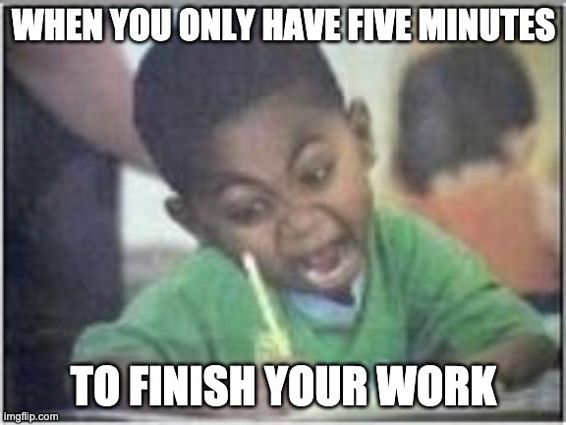
You
Beleaguered programmer wishing they had the time to Do Things Right, asked to Move Way Too Quickly

Slide 4
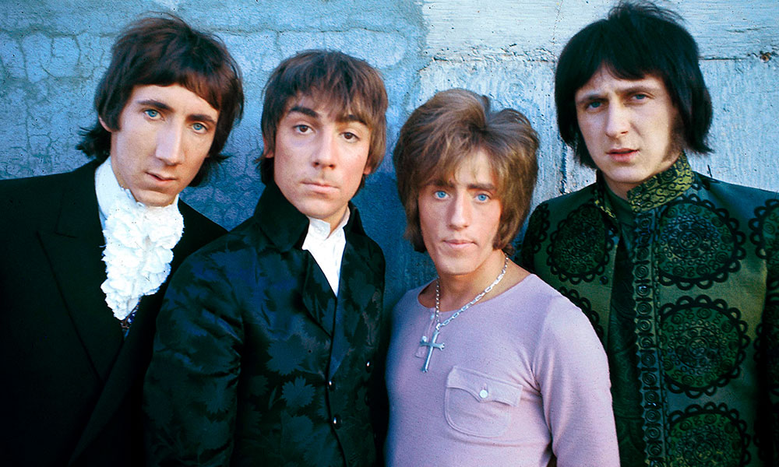
Who (Them)
Who is involved?

Slide 5

Who (is asking?)
Managers:
Throughput
Team metrics
Company optics

Slide 6

Who (is asking?)
Product
User growth
Product iteration
Late Requirements

Slide 7
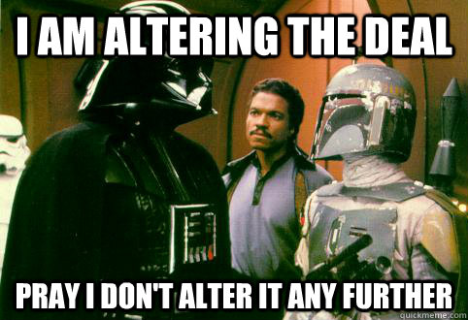
Who (is asking?)
Sales
Deliver on Promises
Features they can sell
Demos & Presentations

Slide 8
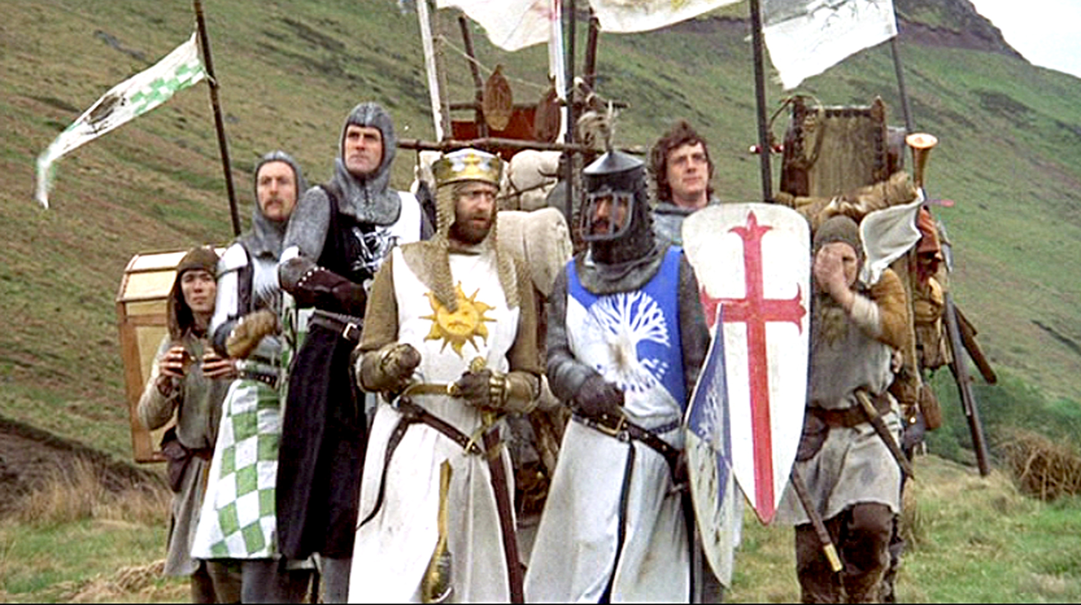
Who (is asking?)
Executives
Life & death
limited visibility
KPIs

Slide 9
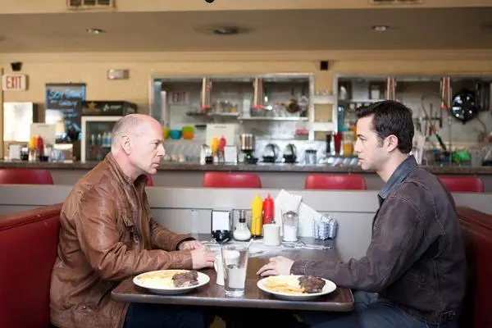
Who (has a stake?)
You, N months from now
Maintenance & Enhancements
On-call rotations
Happiness

Slide 10
Who (cares?)
People who benefit from faster releases
People who depends on a timely release
People who cope with the consequences of Too Fast releases

Slide 11
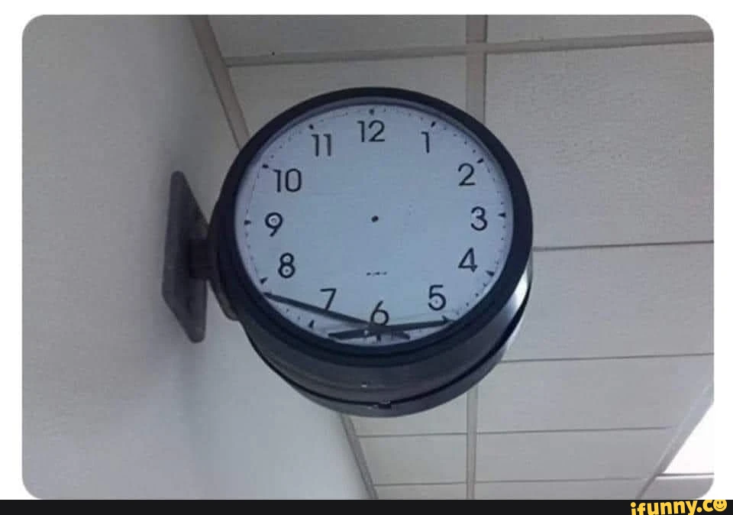
When (does this happen?)
What’s happened to make this necessary in the first place?

Slide 12
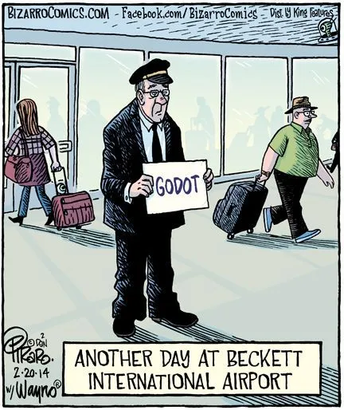
When (are you asked?)
Someone Else is Late
Product took too long writing requirements
Sales over-promised to seal a deal
Execs pivoted

Slide 13
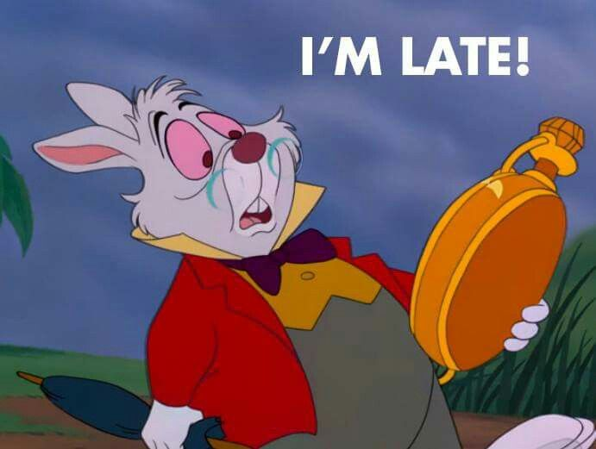
When (are you asked?)
Your Team Is Late
Something else was harder than expected
Team changes
Interrupt Work

Slide 14
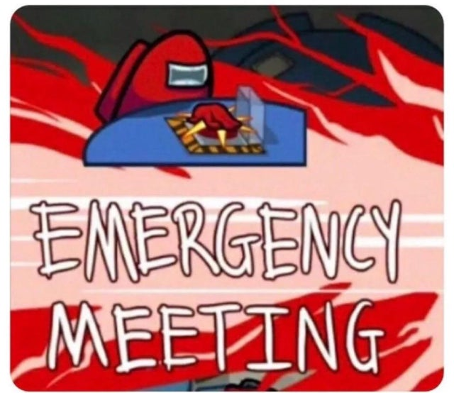
When (are you asked?)
High-Severity Outages

Slide 15
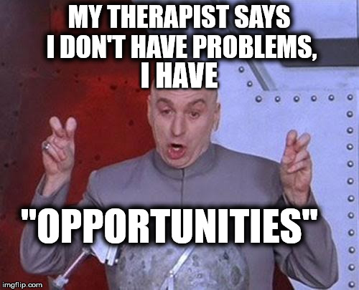
When (are you asked?)
Strategic Play
Real or perceived market opportunity
Something new became possible
Rapid prototyping

Slide 16
When (does it matter?)
Supporting your company
Supporting your colleagues
Supporting your clients
Seizing Opportunities

Slide 17
What (should you do?)
Writing Good Bad Quick Code

Slide 18
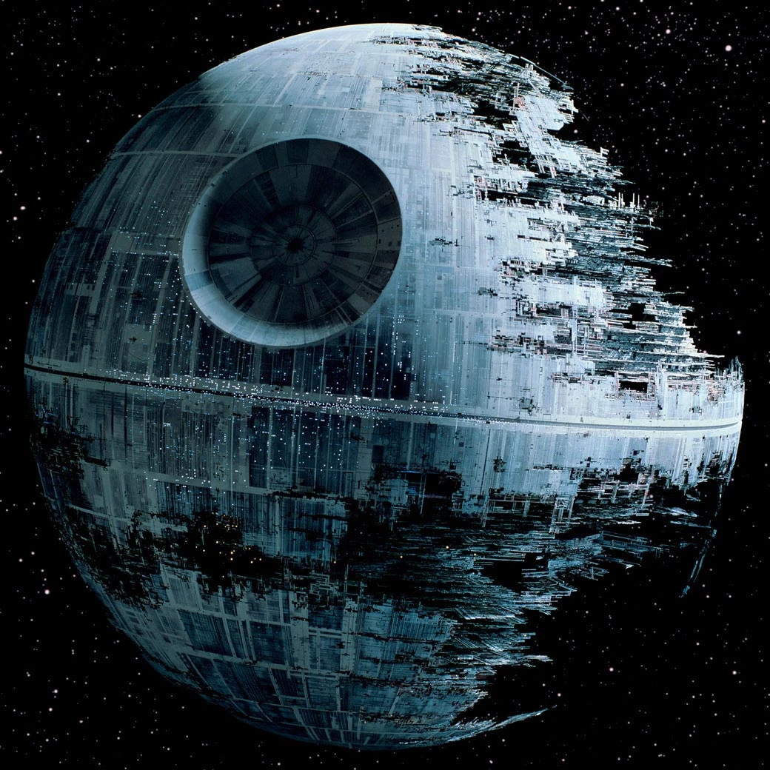
What (should you do?)
Know what to build
THEN
Don’t
(...build all of it)

Slide 19
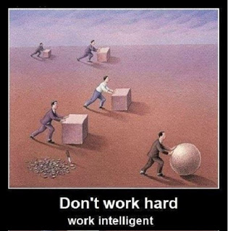
What (should you do?)
Know why you’re cutting each corner that you’re cutting

Slide 20

What (should you do?)
Know which corners can’t be cut, and why, so you can push back with confidence

Slide 21
Writing Good Bad Quick Code
Incomplete good code
Deliberately cut corners
Still does what is most important

Slide 22
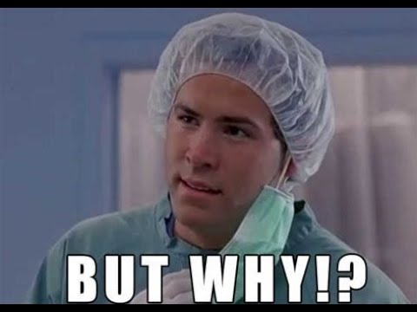
Why (does that work?)
Why do those principles result in good bad quick code?

Slide 23
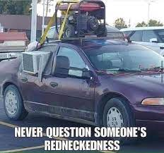
Why (does that work?)
More pain comes from bad code than missing code

Slide 24

Why (does that work?)
Slow Is Smooth,
Smooth Is Fast

Slide 25
Why (is this the Way)?
Bad code hurts more than missing code; missing code has no bugs, adds no dependencies, and leaves room for good code
Going slow to go fast lets you maintain that critical aspect of all code: deliberateness; having a reason & purpose for each line.

Slide 26
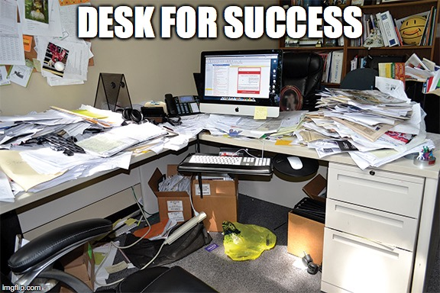
Where (can this be done?)
On top of solid foundations

Slide 27
Where (can this be done?)
Find your stable foundations, then grow from there.

Slide 28
In Conclusion
People have real reasons for you to go Too Fast
Situations have real needs for you to go Too Fast
You can write Good Bad Quick Code
It’s worth it to write Good Bad Quick Code
Write it on top of Good Solid Slow Code

Slide 29
Nicholas Barone
https://github.com/rangerscience
https://www.daybreakhealth.com/ (hiring!)
RubyConf 2021 - Joyful Polyglot: Beautiful insights from many languages
https://www.youtube.com/watch?v=JgWAWwF6pNY
Serial Early Employee
Full stack dev

